Slide 1
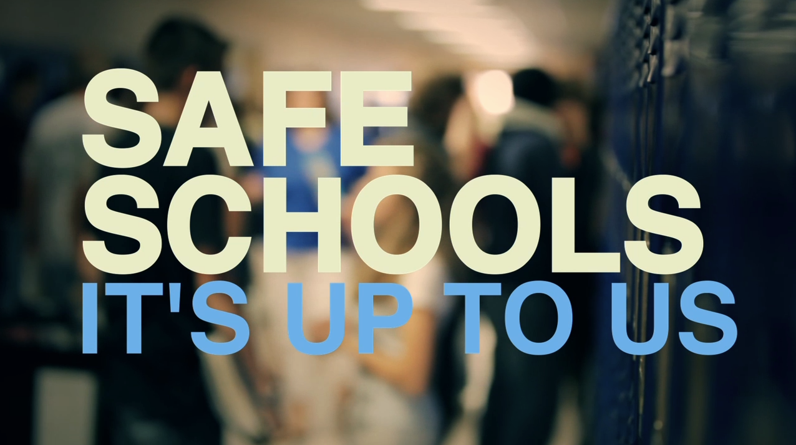

School Safety – A Layered Approach to removing the soft target

Slide 2

School Safety- Lessons Learned
Columbine – 19 years ago – Little has changed in regard to structure hardening
Active shooter events are over in 4 to 6 minutes on average
It takes an average of 2 to 3 minutes for E911 to be called
At Parkland some of the initial calls from those inside the 1200 building went to parents. Parents called 911
Average law enforcement response times are 7-12 minutes
E911 systems from telephone calls flooding in can crash and overload sending the calls elsewhere and enhancing confusion and delay

Slide 3

School Safety-Lessons Learned
We have poured resources and funding into prevention, intervention, mental health, early recognition awareness, early trigger awareness and the list continues. Yet in 2018 we have averaged 1 school related shooting incident in this nation per week
Prevention and intervention are still solid approaches as is mental health, early recognition and trigger awareness but the lacking piece has been structure hardening
Schools can be in fact hardened and not made out to appear as a fortress

Slide 4
School Safety – Lessons Learned
Schools must be looked upon in today’s changed world as key assets and critical infrastructure
The classroom must become protected space or in the event of an active shooter the likelihood of mass murder is very high
In Parkland the killer took a path that a piece of bullet proof glass could have saved many lives
Proof positive of hardening in Parkland with the hurricane rated glass and how that interrupted the plan of the killer and did not open up a pathway to kill more fleeing students
In Santé Fe Texas the killer took a path that a bullet proof door could have saved lives
In Noblesville Indiana neighboring classroom teachers used their dress belts to tether the classroom door

Slide 5
School Safety - Layering
A solid hardening system is layered
Hardening of the structure –Bullet resistance-Protecting the space
Immediate Notification system – Direct to E911
Actionable Intelligence – Direct to E911
Drilling and training protocols for staff and students
Armed Law Enforcement Officers on Campus-SRO’s
Other Considerations

Slide 6
School Safety - Hardening
Bullet resistant glass, doors, classroom doors, locks, hinges
Bullet proof door locks and latches that have an automatic locking mechanism when shut that prevents access from outside but does not ever lock from the inside
Door locking device access can be via a key for an electronic fob
Classroom, library, and cafeteria should be protective spaces
Ballistic glass will protect entry doors and exterior windows
Single points of entry that are bullet resistant and supported outside by protective bollards. A “man trap” at main entrances that are fully protected with bullet resistant glass
Metal detectors and devices that scan students as they enter should be considered

Slide 7
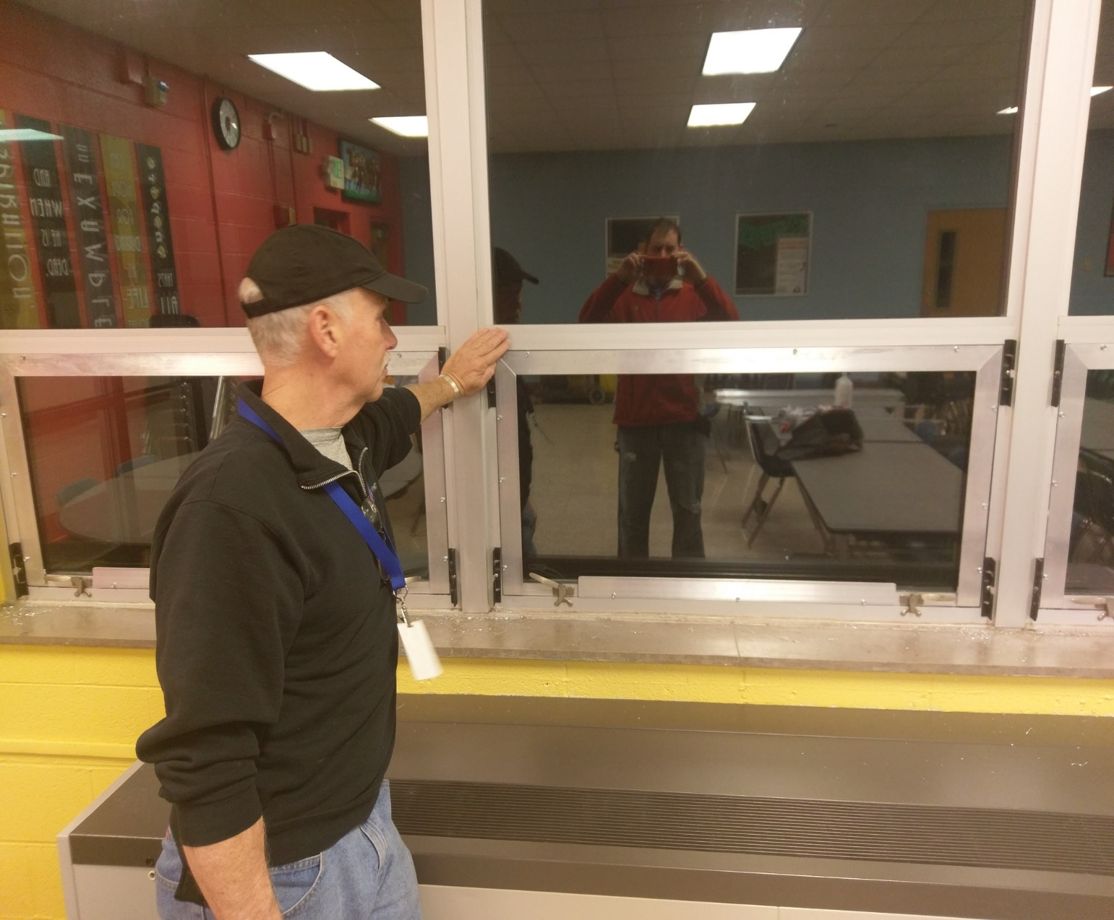
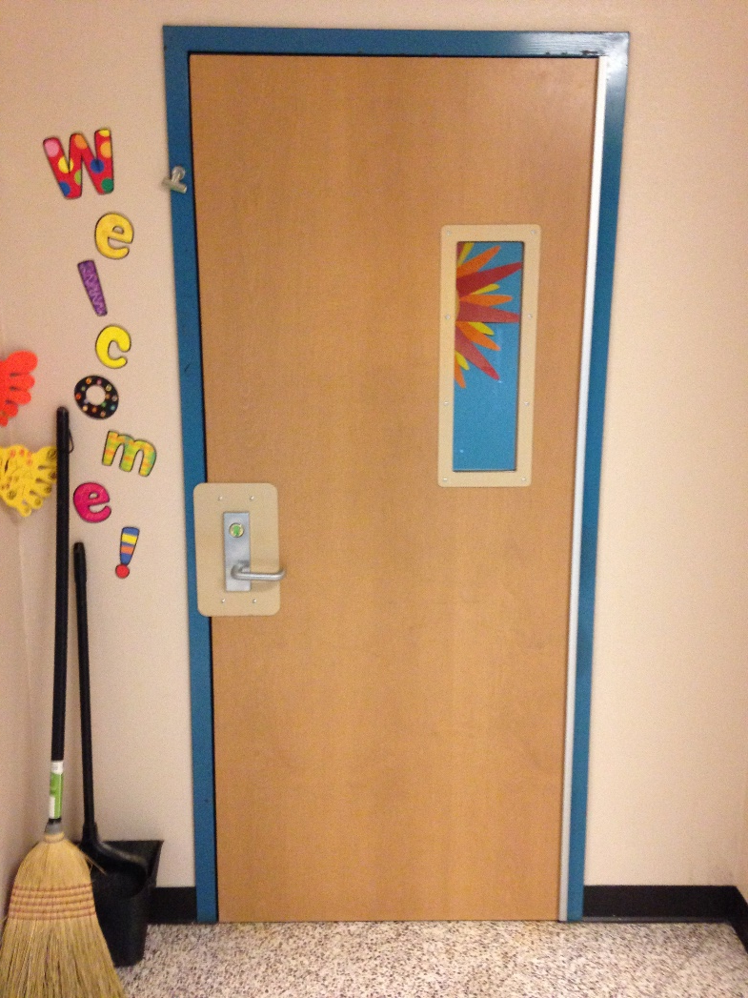

Slide 8
School Safety-Hardening
Alternate options or additions could include K9 officers at entrances with the ability to detect firearms
Metal detectors should require armed law enforcement officers to manage
Protocols should require no entry into the school by anyone during class passing of students
During passing between classes, teachers should be required to stand at their door and monitor actions in hallways
Once passing concludes, classroom doors are all closed to completely protect the space

Slide 9
School Safety - Hardening
Staff should limit entry to “necessary”
Proper identification should be required and purpose to enter necessary.
Visitor should be issued a “visitor” badge and require staff escort during the entire time the person is inside the school
All staff should be required to wear staff identification badges at all times

Slide 10
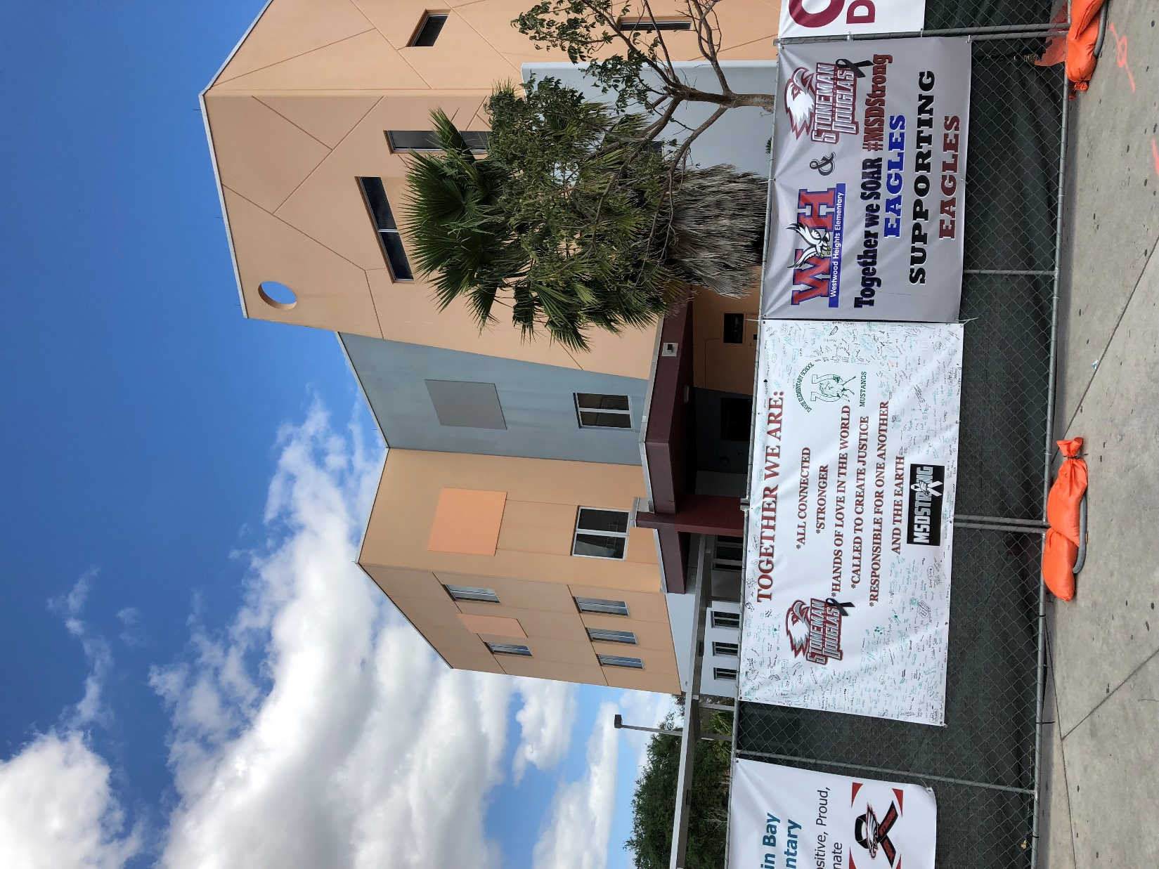
Hardening – Lessons learned-Parkland Florida
In Parkland Florida, the killer made attempts to shoot out hurricane rated plate glass on the third floor
Due to the hurricane rating the glass did not shatter or break apart creating an open window
An open window would have allowed for direct line of fire on top of fleeing students as they ran out the west exit/entrance at the 1200 building
Killer never entered a classroom

Slide 11
Hardening – Lessons learned-Parkland Florida
In Parkland Florida, the killer made attempts to shoot out hurricane rated plate glass on the third floor
Due to the hurricane rating the glass did not shatter or break apart creating an open window
An open window would have allowed for direct line of fire on top of fleeing students as they ran out the west exit/entrance at the 1200 building
Killer never entered a classroom

Slide 12
Hardening – Lessons learned-Sante’ Fe Texas
In Santé Fe Texas, students made attempts to close the door between the killer and the classroom.
The killer simply shot through the door striking the students

Slide 13
Hardening-Lessons Learned-Noblesville IN
In Noblesville Indiana, when the shooting occurred, neighboring classrooms closed their doors
Teachers began to tether the doors with pant belts in an effort to keep the shooter from entering their classrooms
Door tethering is directly from the ALICE training manual
A protected space (classroom) with protected door, viewing glass, door latch device and hinge would eliminate this exposure

Slide 14
School Safety -Immediate Notification
Notification in the event of an emergency needs to be immediate and direct to E911, students and staff on the entire campus
The method used should be in such a manner as it considers gross motor skills
At southwestern the notification system utilizes a simple key fob worn on a lanyard by all teachers and staff
The immediate notification system must contain an audible alarm for the entire campus that not only covers the inside of the structure but outside the immediate campus.

Slide 15
School Safety-Immediate Notification
Immediate text message alert upon fob being activated
Text messages can be immediately sent to all school staff, selected important personnel and all law enforcement in the district
The immediate notification system must be supported by proper training and protocols for all staff and students on exactly what to do in the event of an alarm
Reaction should be immediate and directly to the nearest hardened classroom or room. Students should be instructed to a clearly marked portion of the room, away from the fan of fire from the doorway or window

Slide 16
School Safety – Immediate notification
Students should be trained to respond to these safe corners inside the protected space and place stacked desks, books or other nearby items around to protect from any shrapnel or debris from vital organs
The average call to E911 in an active shooter event is 2 to 3 minutes
Most of the information received is from a frantic person with vague information or a third part

Slide 17
School Safety – Actionable Intelligence
Actionable intelligence is best obtained by direct internet protocol (IP) Virtual private Network (VPN) secure connection to cameras and floor plans by an E911 operator
The E911 Emergency Response Stations should have a Graphic User Interface that provides the E911 center immediate notification, and actionable intelligence at the time of the attack
All the apps and other systems currently available lack this
E911 can now relay vital accurate real time information to responding law enforcement

Slide 18
School Safety – Actionable Intelligence
True actionable intelligence gives us
real time suspect movements
actual locations at all times
weapons platform
descriptors
how many assailants
nearby wounded-casualties
speed and direction of event

Slide 19
School Safety – Actionable Intelligence
Smart phone applications as an example will give us immediate notification but it will only be at the time and general location of the event
We know these events are fluid and can cover much ground quickly thus telling us we need to see inside to know what is happening in order to respond to it accurately and without delay
Time is critical. Actionable intelligence along with immediate notification takes back valuable time taken by the attacker and places it in the hands of responding law enforcement

Slide 20
School Safety-Actionable Intelligence
Direct communication from inside each classroom to E911
Call boxes and simple toggle switches work well that feed real time information about what is happening inside a particular classroom
Safe-under attack-medical emergency as an example. Students and teachers should be as quiet as possible. Talking on telephones should be avoided

Slide 21
School Safety-Actionable Intelligence
Tactical tablets that are directly fed to/from the E911 system can be carried inside the structure by responding law enforcement
Tactical Tablets give the “boots on the ground” the direct visual as opposed to radio relayed
With proper systems it can also give the ability to unlock doors that are locked with little to no effort
If key card/fob access is not available to responders, specific perimeter entry doors should be electronically controlled from an Emergency Response station located at E 911. These doors are identified on the GUI and physically by a blue strobe

Slide 22
School Safety-Actionable intelligence lesson learned
At Marjory Stoneman Douglas the killer walked out with the fleeing students.
Responding law enforcement had access to a closed camera system at the school that had a delay. They had no idea the killer fled and feared that he was still inside creating a hostage situation.
A good actionable intelligence piece would have told responding law enforcement that he was leaving the 1200 building
This situation created more devastation to the wounded as emergency responders held and left the wounded without responding help

Slide 23
School Safety – The building fights back
A final component of the actionable intelligence piece is the use of countermeasures
Smoke is the first countermeasure that should be considered
Activated by the E911 center, its purpose is to drive the shooter away from the protected spaces and into the hands of responding law enforcement.
This allows the structure to fight back BEFORE law enforcement arrives
It is also a fire retardant product that doubles as a fire extinguisher should a bomb or incendiary device be deployed by the killer
Another countermeasure to be considered is the use of a distraction device

Slide 24


Slide 25
School Safety-Actionable intelligence-Lesson Learned
In Parkland Florida the killings occurred in approximately 3 minutes
The best chance to mitigate is to have protected space and systems that allow for the structure to fight back BEFORE law enforcement arrives

Slide 26
School Safety-Drilling and protocol considerations
Staff and students should regularly drill on how to react properly to the active shooter alarms as well as the fire alarms
The two going off have created confusion
Fire codes and response to fire alarms by students and staff should be re-evaluated for the active shooter situation. Changes should be made that best address both problems in an effort to prohibit an active killer from using one system to further gain their mission
Once students are evacuated they are now removed from their protected space and more vulnerable to attack
Indiana has just opened up the fire evacuation time to allow for up to 3 minutes before students are forced to evacuate their classroom
In southwestern HS Shelbyville, 30 seconds is the standard

Slide 27
School Safety-Drilling and protocol considerations
At first this will be unsettling but with anything else requiring change it will become accepted and then the reaction will be swift and proper
Proven at Southwestern HS Indiana with students, teachers, administrators and parents

Slide 28
School Safety – Conventional Vs. Virtual Reponses
Comparing virtual command response to conventional responses today by law enforcement, it is very compelling what law enforcement can do for our schools and students with a fully layered system in the event of an active shooter
Realistic dual test using Louisiana City, Sheriff and State law enforcement in a school shooting scenario
Officers were not briefed on situation, only that it was a realistic drill of some sort
One team responded under conventional methods of response and the second team responded under virtual command using the NetTalon model

Slide 29
School Safety – Conventional Vs. Virtual Reponses
Under conventional response, law enforcement did not arrive at the school until 7 minutes 10 seconds into the drill
Under virtual command the following timeline occurred:
5 seconds – Teacher activated key fob. E911 notified
16 seconds – Principal places entire school on lockdown
45 seconds – Students all in lockdown. 911 has not been called yet. Police however are already responding
50 seconds – Principal calls 911. Law enforcement already aware of situation and responding
1min17sec – Responding law enforcement receive a layout of school, description of shooter(s), real time positions of the shooter(s) in the school, areas in school that are safe and areas that are under attack

Slide 30
School Safety – Conventional Vs. Virtual Reponses
4min27sec – Law enforcement moving into the building directly towards the shooter(s) based on real time intelligence fed to them from the system
4min40sec – Shooter(s) confronted by law enforcement
6min24sec – Shooter neutralized
RESULTS…
Conventional response – 23 dead with 24 wounded
Virtual response – 1 dead with 4 wounded

Slide 31
School Safety- Other compliments to hardening
Armed Law Enforcement Officers or SRO’s
Armed Law Enforcement assigned to school campuses can increase response time
At minimum one in each district but some districts are large and have structures spread out
Their purpose should be clearly defined and their involvement in school discipline matters limited. They are there for security and law enforcement purposes first
Agencies should consider rotating these positions to keep law enforcement officers grounded
A sworn law enforcement officer employed by an agency that is governed under state law, court rulings and agency policy is the best
Some schools have their own police departments. Some of those are small and have little to no policies on reporting systems or information sharing

Slide 32
School Safety – Other compliments to hardening
Terroristic Threat Laws. Currently Indiana has only intimidation. Law enforcement needs more and improved tools to investigate threats made indirectly or with the use of social media targeting mass murder or “shooting up” a structure
Indiana HEA 1421 section (b)2 states “limit referrals to law enforcement and arrests on school property to cases in which referral to law enforcement or arrest is necessary to protect the health and safety of students or school employees”
This is how the Parkland Killer and many others fall through the gaps
Consideration that any crime on public school property should be reported
Calling law enforcement for help in prevention when we are at the end of the crime scale with reporting as opposed to the start of the crime scale is another gap that killers fall through
Schools should be required to share information with any requesting law enforcement agency

Slide 33
School Safety- Putting it all together
#1. Protect the space. Students and staff are in need of immediate and protected spaces in our schools. Schools are targeted because they are easy, soft targets.
#2. Immediate notification direct to E911. Taking back valuable time from the attacker and giving it to responding law enforcement officials. How many lives can be saved in 2 to 3 minutes
#3. Actionable intelligence. Taking back more valuable time by making the law enforcement response deliberate and accurate
#4. Regular drills and protocols for students and staff on how and where to properly react to an active shooter event
#5. Armed Law enforcement already on campus (SRO’s) can greatly increase response times
#6. Other considerations like metal detectors, K9 use, terroristic threat laws and proper information sharing can assist with prevention and intervention

Slide 34
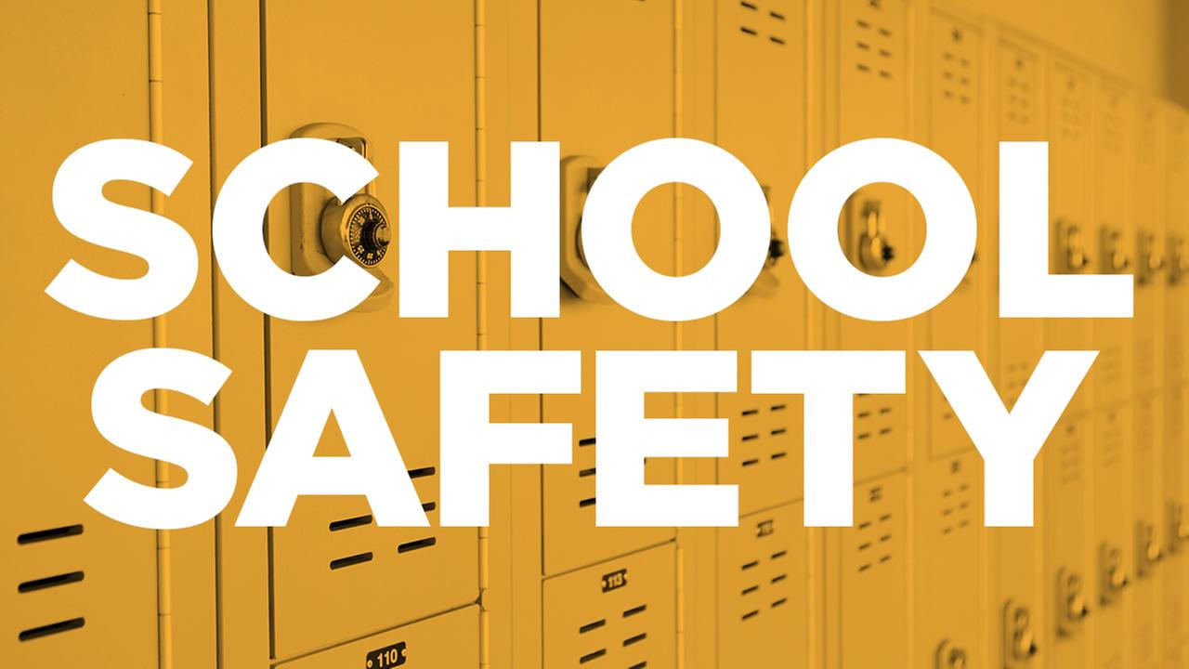
School Safety – Bringing it all together
Inside America’s Safest School

Slide 35

School Safety – A Layered Approach to removing the soft target
Indiana Sheriffs Association
317-356-3633

