Slide 1

LAW ENFORCEMENT and
OLDER DRIVERS
Cpl. Kelli Brookshire
TRIAD Coordinator
Oklahoma County Sheriff’s Office

Slide 2
What we’ll discuss:
Oklahoma County TRIAD Program
Effects of Aging on Driving Skills
The National Approach
Oklahoma County’s Older Driver Safety Program
Law Enforcement Response

Slide 3
What is TRIAD?
Governed by the National Sheriff’s Association
Crime prevention and safety program for people over 55 aimed to teach older adults ways to prevent becoming a victim of crime
Partnerships are the KEY to
establishing S.A.L.T. Councils
throughout your jurisdiction
(Seniors & Law Enforcement Together)
SHERIFF
POLICE
SENIORS

Slide 4
Oklahoma County TRIAD
Established in 1995 under the direction of OCSO
Continues to operate under the direction of Sheriff John Whetsel and the TRIAD Coordinator
Currently operating 11 S.A.L.T. Councils that meet on a monthly basis:
Choctaw
Del City
Edmond
Harrah
Luther
Midwest City
North OKC
South OKC
Eastside OKC
Warr Acres
Village/Nichols Hills

Slide 5
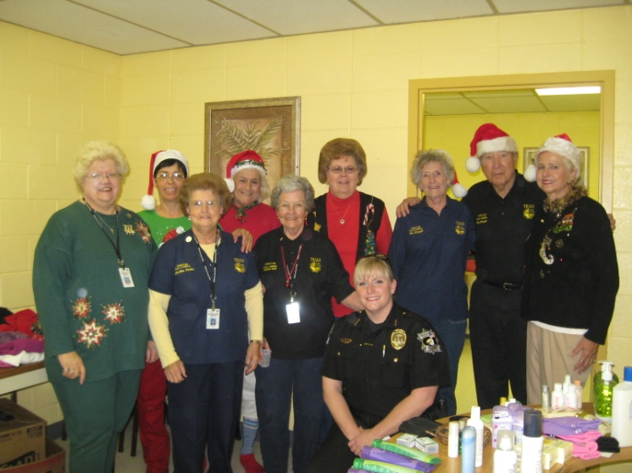
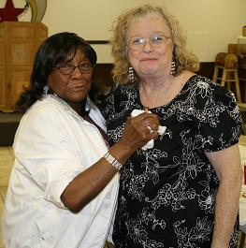
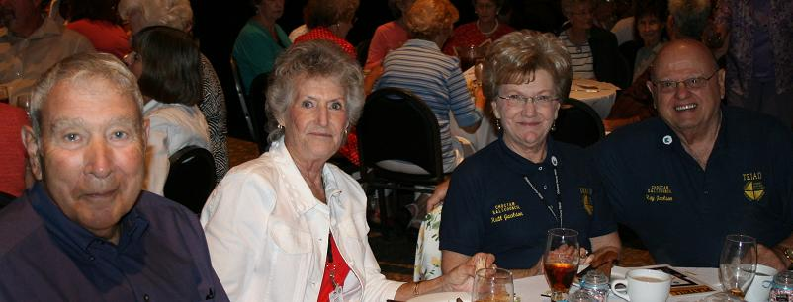
What we do…
S.A.L.T. Councils
Senior Awareness Day
Elder Law Day
Informed Senior Seminar
Young at Heart Senior Prom
TRIAD Appreciation Luncheon
9-1-1 Cell Phone Program
Older Driver Safety Day
Christmas at Oakhill
Grandparents Raising Grandchildren
Over 250 lectures annually

Slide 6
U.S. Life Expectancy
*Courtesy of the U.S. Census Bureau

Slide 7
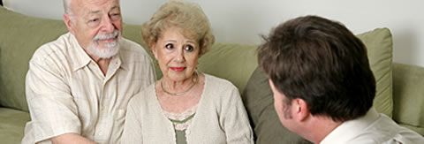
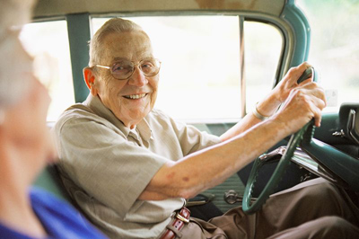
The Older Driver Dilemma
Chances are, you will be involved in a talk of this nature eventually. You might be the one initiating the conversation within your own family, or you might be out on the streets.
Prepare
yourself
early!

Slide 8
Effects of aging on driving skills
Cataracts
Macular Degeneration
Glaucoma
Stroke
Arthritis
Medications
Parkinson’s Disease
Sleep Apnea
Alzheimer’s Disease

Slide 9
Cases of Dementia
*Snellgrove, 2005

Slide 10

Approaching Alzheimer’s:
Make Your First Response the Right Response
A training video for law enforcement

Slide 11
Oklahoma County Sheriff’s Office
Older Driver Safety Program
Grant and program proposal submitted to NSA and NHTSA in late 2009, and approved in early 2010
Set up curriculum through NHTSA’s DriveWell program
Introduced to members throughout summer 2010
Culminated with Older Driver Safety Day in August 2010
    Lectures
    Panel Discussion
    Resource Fair
    Vehicle Safety Inspections (Traffic Safety Unit)
Program Manual for Law Enforcement

Slide 12
What we’re teaching…
Small, informational segments inserted into normal S.A.L.T. Council meetings
    Staying Healthy for Driving Fitness
      Build strength & endurance
      Know your medications
      Get enough sleep
      Have your eyes checked annually
      Get regular physical check-ups
    Giving Up the Keys: Easier Said Than Done
    Steps to Improve Driving Ability
    CarFit

Slide 13


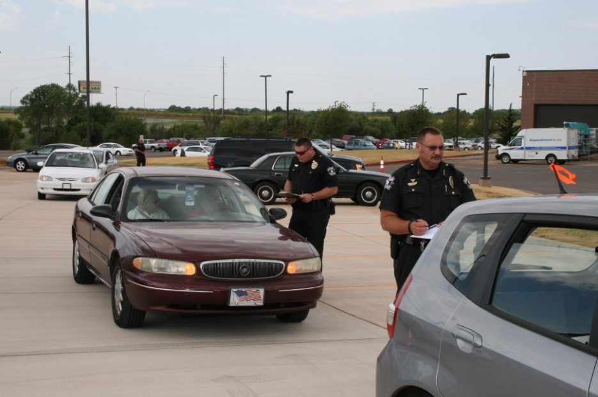


What is CarFit?
CarFit is an educational program that “fits” older
adults to their vehicles.
www.car-fit.org

Slide 14
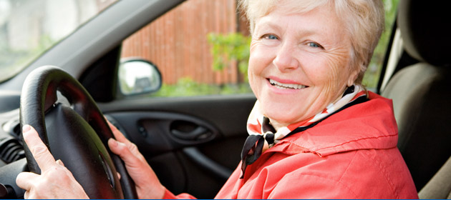
How will you know who could be at risk?
Obvious signs
  Creation of a traffic hazard
  Physically-evident medical issues
  Medical alert window stickers
  Signs and/or symptoms we’ve discussed
Things you might have to look for
  Medical alert card in the wallet
  Prescription bottles in the purse or glove box
  Medical alert bracelet, watch, or necklace
  Alzheimer’s Association SafeReturn symbol

Slide 15
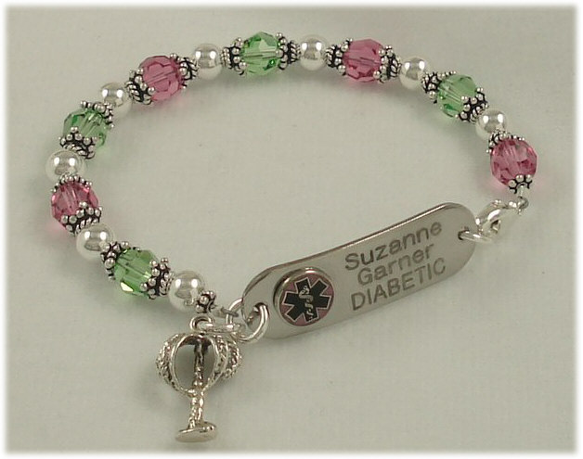
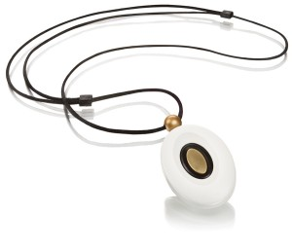
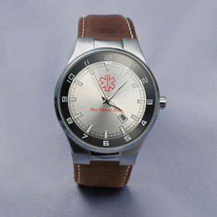
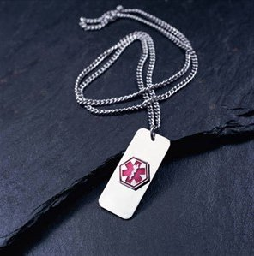
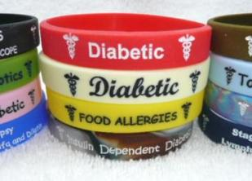

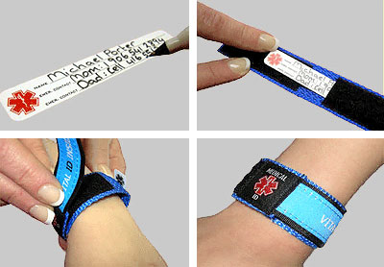
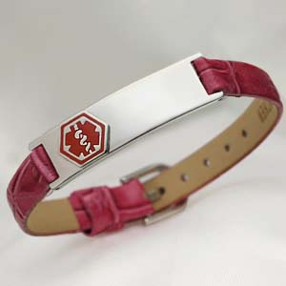
Medical Alerts:
Pay attention!
Watch for clues that might be hidden in plain sight!

Slide 16
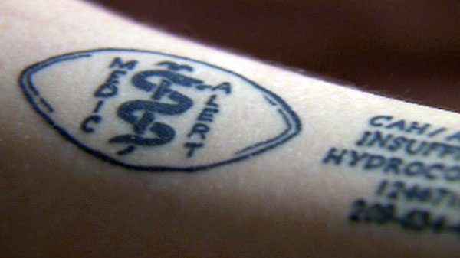
And for those who might lean toward the extreme…
WOW!

Slide 17
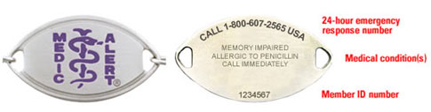
Alzheimer’s Association
Medic Alert & Safe Return
If you encounter a bracelet like this, with the purple engraving, you are dealing with an Alzheimer’s patient. Adjust your response accordingly, and contact dispatch.

Slide 18
How would you respond?
The OCSO Model Policy

Slide 19


For more information or to contact available local resources:
Cpl. Kelli Brookshire
TRIAD Coordinator sokelbro@oklahomacounty.org
405-713-1950

