Slide 1
Triad – Top Schemes, Scams, and types of Older Adult Abuse
What they are. What you can do to keep your community informed

Slide 2


Why are our older adults vulnerable?

Slide 3

Older adults have high levels of trust with regard to: strangers telephone salespersons contractors utilities/other workers officials, and others they deal with.

Slide 4
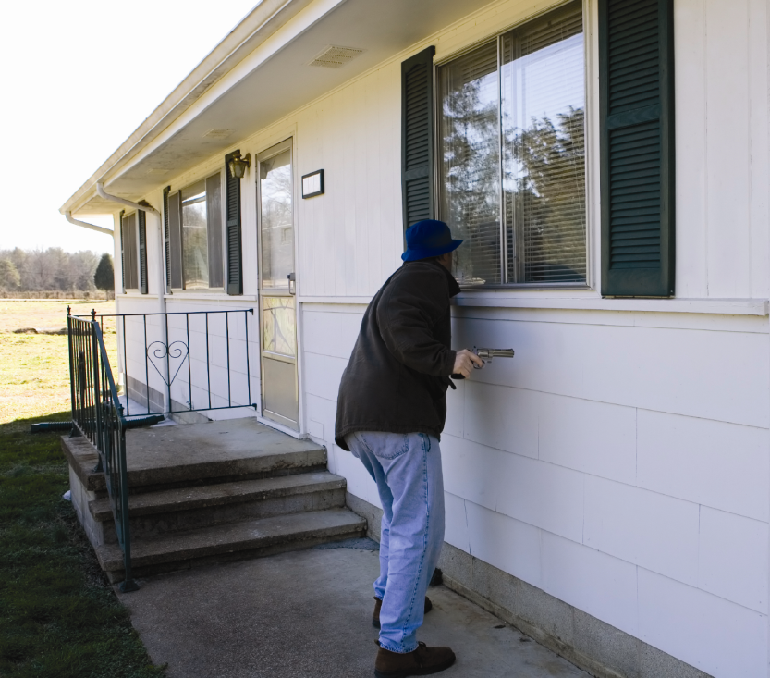
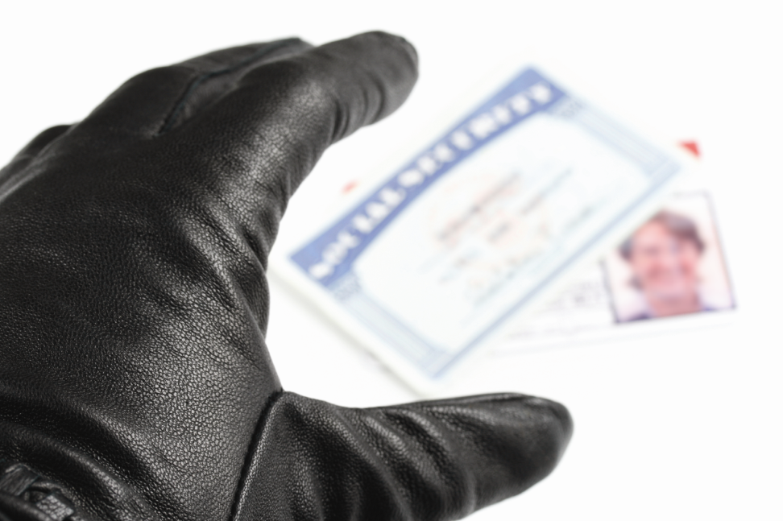
Nobody is guarding the henhouse!
They become an easier target for:
home invasion
dishonest contractors
fraudulent banking transactions
Identity theft, and other scams.
Notes:
Department of Justice’s Bureau of Justice Statistics report older adults as the least affected by crime. However, the National Center on Elder Abuse, backed by studies done by AARP demonstrate that as much as 84% of older adults do not report crimes perpetrated against them. In between, Older adults are losing their wealth, their health, and their self worth.

Slide 5

Older adults are also victimized by violent crime, including mugging, sexual violence, physical and mental domestic abuse, neglect, and intimidation. Memory-impaired older adults are even more vulnerable to these crimes.
Notes:
Lets look at some of the top types of financial victimization that affect older adults.

Slide 6
Top Eleven FTC Complaints
Rank Category Complaints %
1 Identity Theft 258,427 32
2 Shop-at-Home/Catalog Sales 62,811 8
3 Internet Services 42,266 5
4 Foreign Money Offers 32,868 4
5 Prizes/Sweepstakes and Lotteries 32,162 4
6 Computer Equipment and Software 27,036 3
7 Internet Auctions 24,376 3
8 Health Care Claims 16,097 2
9 Travel, Vacations, and Timeshares 14,903 2
10 Advance-Fee Loans and Credit
Protection/Repair 14,342 2
11 Investments 13,705 2
Notes:
Here is the top list of FTC Complaints. How many of these do you think directly target older adults?

Slide 7
Top Eleven FTC Complaints
Rank Category Complaints %
1 Identity Theft 258,427 32
2 Shop-at-Home/Catalog Sales 62,811 8
3 Internet Services 42,266 5
4 Foreign Money Offers 32,868 4
5 Prizes/Sweepstakes and Lotteries 32,162 4
6 Computer Equipment and Software 27,036 3
7 Internet Auctions 24,376 3
8 Health Care Claims 16,097 2
9 Travel, Vacations, and Timeshares 14,903 2
10 Advance-Fee Loans and Credit
Protection/Repair 14,342 2
11 Investments 13,705 2
Notes:
These are the FTC complaints that affect older adults! Lets look at a few of these.

Slide 8

Identity Theft
Identity theft occurs when someone uses your personally identifying information, like your name, Social Security number, or credit card number, without your permission, to commit fraud or other crimes.
The Federal Trade Commission estimates that as many as 10 million Americans have their identities stolen each year.
Notes:
IDTheft Consumer Education Kit [en español] Folder/Kit includes everything you need to educate your community about how to deter, detect, and defend against identity theft. DVD of 10 minute video, CD with resources, How-To Guide, publication samples. 9"x12", color. Maximum order of 10 copies. http://www.ftc.gov/bcp/edu/microsites/idtheft/consumers/deter-detect-defend.html

Slide 9

Identity Theft
File a Police Report
Contact your Bank
Contact Three Major Credit Bureaus
Contact your Credit Card Issuers
Obtain New Identity Documents
File Complaint with the FTC.org
Complete the Identity Theft Affidavit
Contact the Attorney Generals Office
www.ftc.gov
Notes:
What to do if you are the victim of ID theft. But what can you do to deter identity theft?

Slide 10
Deter Identity Theft
Deter identity thieves by safeguarding your information
Shred financial documents
Protect your Social Security number.
Don’t give out personal information on the phone, through the mail, or over the Internet
Notes:
Never click on links sent in unsolicited emails; instead, type in a Web address you know. Use firewalls, anti-spyware, and anti-virus software to protect your home computer; keep them up-to-date. Visit
OnGuardOnline.gov for more information
Don’t use an obvious password
Keep your personal information in a secure place at home, especially if you have roommates, employ outside help, or are having work done in your house.
Now lets detect Identity Theft…

Slide 11
Detect Identity Theft
Detect suspicious activity by routinely monitoring your financial accounts & billing statements
Be alert to signs that require immediate attention:
Mail or bills that do not arrive
Unexpected credit cards or account statements.
Denials of credit
Calls or letters about purchases you did not make.
Notes:
Inspect Your credit report.
Review Your financial statements.
Order your credit report:
T he law requires the major nationwide credit reporting companies – Equifax, Experian, and TransUnion – to give you a free copy of your credit report each year if you ask for it.
Visit www.AnnualCreditReport.com or call 1-877-322-8228, a service created by these three companies, to order your free credit
reports each year. Or you can complete the Annual Credit Report Request Form and mail it to: Annual Credit Report Request
Service, P.O. Box 105281, Atlanta, GA 30348-5281. You can download the form at ftc.gov/freereports.
Finally, the best offense is a good defense!

Slide 12
Defend Against Identity Theft
Defend against Identity Theft as soon as you suspect a problem
Place a “Fraud Alert” on your credit reports, and review the reports carefully.
The three nationwide credit reporting companies have toll-free numbers for placing an initial 90‑day fraud alert; a call to one company is sufficient
Notes:
Equifax: 1-800-525-6285
Experian: 1-888-EXPERIAN (397-3742)
TransUnion: 1-800-680-7289
U se the Identity Theft Affidavit at ftc.gov/idtheft to support your written statement.
File a police report.
Report your complaint to the FTC.
Online: ftc.gov/idtheft
By phone: 1-877-ID-THEFT (438-4338) or TTY, 1-866-653-4261
Lets move on to other types of frauds and scams…

Slide 13
Prizes, Sweepstakes, and Lotteries – Oh My!
Scammers use a free promotion to convince consumers to send in money to claim a prize
To claim the prize, a fee to cover taxes or service charges are required
Scammers convince the consumer to wire money to a foreign country via WU or MoneyGram before a prize will be mailed
Technology allows phone numbers to be traceable back to a legitimate source
Notes:
Lets go back to the top FTC complaints that affect older adults and how criminals get them to part with their savings. Here are a few techniques…

Slide 14
Prizes, Sweepstakes, and Lotteries – Oh My!
You do not have to pay to enter a sweepstakes. If you are asked, it is a scam.
Bait and switch – you are offered a fabulous prize but get a dud.
If another country is mentioned, it’s a scam
Scammers may use legitimate business names, steal letterhead, to look legitimate
Some use government agency names
Call your Attorney General’s Office
Notes:
What can you do if you suspect fraud? How can you tell if you have been defrauded?

Slide 15
Prizes, Sweepstakes, and Lotteries – Oh My!
Legitimate Lotteries don’t ask for funds in advance of paying out prize money
US Law prohibits cross-border sale or purchase of lottery tickets by phone or mail
Legitimate lotteries require the winner to contact THEM!
If you did not buy a lottery ticket, YOU COULD NOT HAVE WON a lottery!
Check www.ftc.gov

Slide 16
Investment Schemes
"Our fight against fraud never stops because each year con artists discover new ways to fleece the public. Sadly, many of the age-old scams still work to cheat victims of their hard-earned savings as well."
- Ralph A. Lambiase, NASAA president and director of the Connecticut Division of Securities.

Slide 17
The Top Ten List
Ponzi Schemes
Senior Investment Fraud
Promissory Notes
Unscrupulous Stockbrokers
Affinity Fraud
Unlicensed Sellers
“Prime Bank” Schemes
Internet Fraud
Mutual Fund Business Practices
Variable Annuities
Notes:
The quest for a safe investment vehicle is the common theme in all the scams. The top 10, ranked by North American Securities Administrators Association and roughly in order of prevalence or seriousness:
1. Ponzi schemes. The formula is simple: Promise high returns to investors and use their money to pay previous investors.
According to the NASAA, Ponzi scammers often blame government intervention for the failure of their system. In Mississippi last year, two Ponzi scammers pled guilty to a scheme that bilked 41 investors from four states out of $10.2 million. They told investors they were taking part in a money-trading program. The program never existed.
2. Senior investment fraud. Record-low investment rates, rising health care costs and an increased life expectancy have set seniors up as targets for con artists peddling investment fraud -- like Ponzi scams, unregistered securities, promissory notes, charitable gift annuities and viatical settlements.
3. Promissory notes. These are short-term debt instruments often sold by independent insurance agents and issued by little-known or nonexistent companies.
4. Unscrupulous stockbrokers. As share prices tumble, some brokers cut corners or resort to outright fraud, say state securities regulators. And investors have discovered their financial adviser has been bilking them via unexplained fees, unauthorized trades or other irregularities.
5. Affinity fraud. scammers use their victim's religious or ethnic identity to gain their trust and then steal their life savings.
6. Unlicensed individuals, such as independent insurance agents, selling securities. Scam artists use high commissions to entice independent insurance agents into selling investments they may know little about. The person running the scam instructs the unlicensed sales force to promise high returns with little or no risk.
Investors approached by an independent agent should first call the state's securities regulator and ask if the salesperson is licensed. Then ask whether the investment being offered is registered.
7. "Prime bank" schemes. Con artists promise investors triple-digit returns through access to the investment portfolios of the world's elite banks. Purveyors of these schemes often target conspiracy theorists, promising access to the "secret" investments used by the Rothschilds or Saudi royalty.
8. Internet fraud. According to NASAA, Internet fraud has become a booming business. Federal, state, local and foreign law-enforcement officials targeted Internet fraudsters during Operation Cyber Sweep. They identified more than 125,000 victims with estimated losses of more than $100 million and made 125 arrests.
"The Internet has made it simple for a con artist to reach millions of potential victims at minimal cost," says Lambiase. "Many of the online scams regulators see today are merely new versions of schemes that have been fleecing off-line investors for years."
9. Mutual fund business practices. Recent mutual fund scandals have made the national news and attracted the attention of investors and launched several investigations.
10. Variable annuities. As sales of variable annuities have risen, so have complaints from investors -- most notably, the omission of disclosure about costly surrender charges and steep sales commissions. According to the NASAA, variable annuities are often pitched to seniors through investment seminars -- but regulators say these products are unsuitable for many retirees.
FBI Investment Fraud Hotline
(210)650-6777

Slide 18
Sweetheart Scams
“…a man who had little interest in lavish living was writing checks for condominium fees, insurance, taxes and major home improvements on property she bought solely in her own name. He paid bills for department stores and clothing boutiques, hairdressers and day spas, tennis lessons and dinner theaters. A Mercedes.”
-Gail Bensinger
Notes:
Sweetheart scams can arrive by e-mail, spam, online profile, classifieds, or chat rooms.
Grocery stores, banks, and casinos
About 30% of online personalities are scams
Romance turns to money requests or to cash checks and wire funds, or provide personal banking information
Prosecution is difficult because the victim rarely cooperates
www.romancescams.org
www.scamwatch.gov.au
http://www.wiserwomen.org/pdf_files/nurses/WISERNurseScam.pdf

Slide 20
Finally, Mortgage Fraud
“Target the most vulnerable”
Equity Stripping or Bailout – the homeowner is “rescued” by the scammer helping the homeowner get rid of the house. Homeowner surrenders the title, the scammer strips the equity with new loans. Homeowner loses the house anyway
Notes:
And the biggest cash windfall for criminals is mortgage fraud. How does it work? Here is one scenario.

Slide 21
More Mortgage Fraud
Phantom Help – the scammer charges very high fees for basic phone calls and paperwork the homeowner could do. Promises representation. Often insists calls and notices from lender be ignored. Result? Foreclosure.
Notes:
Another way to separate the owner from the house and/or equity in the house.

Slide 22
And More Mortgage Fraud
Bait and Switch – scammer poses as legitimate housing counselors with legal documents for new loans. The documents, in reality, gives the asset to the scammer but not the loan. Result? The homeowner owes the debt but no longer owns the asset.

Slide 23
Don’t fall for promises
Don’t sign away ownership of property (quit claim deed/grant deed)
Beware the contract where you aren’t formally released from liability for your mortgage.
Call your lender – ask for the loss mitigation department.
Call the police, Attorney General, and a good attorney!
Notes:
What can you do if you are involved in mortgage fraud, or suspect mortgage fraud?

Slide 24
Triad 101
By: Edward Hutchison
National Association of Triads, Inc.
ehutchison@sheriffs.org
National Sheriffs’ Association
1450 Duke Street
Alexandria, VA 22314
(800) 424-7827 x326

Slide 25





What is “Triad”
Triad is not an acronym, it is a symbol of unity between law enforcement, older adults, and the community organizations with a vested interest in older adults

Slide 26



Triad is also…….
……. a program of philosophy which focuses on reducing criminal victimization of older Americans, and the enhancement of the delivery of law enforcement services to these individuals.

Slide 27
WHY ?
Dec. 1, 2011 – Senior citizens – that includes people 65 and older – are now at the top of the heap in U.S. Census numbers. The senior age group is now, for the first time, the largest in terms of size and percent of the population in the U.S. This age group grew at a faster rate than the total population between 2000 and 2010, according to a 2010 Census brief released yesterday.
Notes:
USDOJ polls indicate that crime and the fear of crime impact severely on older adults. We must identify and offer ways to deal effectively with crimes targeting them.

Slide 28
More …..WHY ?
An aging population
Increased demands on law enforcement to meet needs of older citizens
Law enforcement will devote special attention to this community-Now or Later!
Crimes specifically TARGETED toward this community
Notes:
Frauds and scams, purse-snatching, pick-pocketing, theft of checks from the mail, and crimes in long-term care settings more often happen to older adults, according to AARP studies. Financial crimes of many degrees of severity are increasingly being uncovered. Abuse is another crime that specifically targets older adults.

Slide 29
What are the goals of Triad ?
Reduce older adult victimization
Enhance a sense of security among older adults through education, training and involvement
Improve the overall quality of life for older adults

Slide 30
Who can be involved in Triad ?
Sheriff
Police
Older Adults
RSVP
Area Agency on Aging
AARP
Meals on Wheels
Fire departments
Community aging programs
Court systems
Local businesses
Churches
Hospitals
Social services
Recreation departments
ANY BUSINESS OR PERSON CONCERNED WITH SENIOR ISSUES
Notes:
Gather together your partners dedicated to curbing crimes committed against older adults.

Slide 31
S.A.L.T. Council
Seniors
And
Law enforcement
Together
Notes:
What is the first step of a Triad?

Slide 32

What is the S.A.L.T. Council?
The governing body of older adults and agency representatives that guide the entire Triad
Creates programs involving law enforcement, older adults and the community to achieve the goals set by the S.A.L.T. council

Slide 33

How is Triad set up ?
Triad Membership

Slide 34

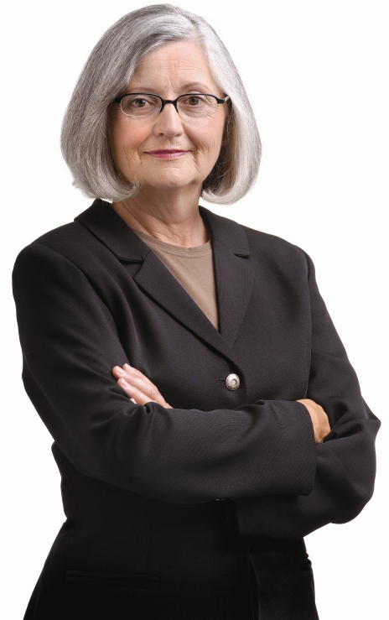

Organizing a S.A.L.T. Council
Gather law enforcement, business professionals, and mature leaders to guide your Triad
Determine the number on the Council
Choose a motivated older adult as
chairperson
Develop a mission statement and
formal guidelines
Determine primary focuses of
YOUR Triad ( survey )
Develop sub-committees for
projects

Slide 35
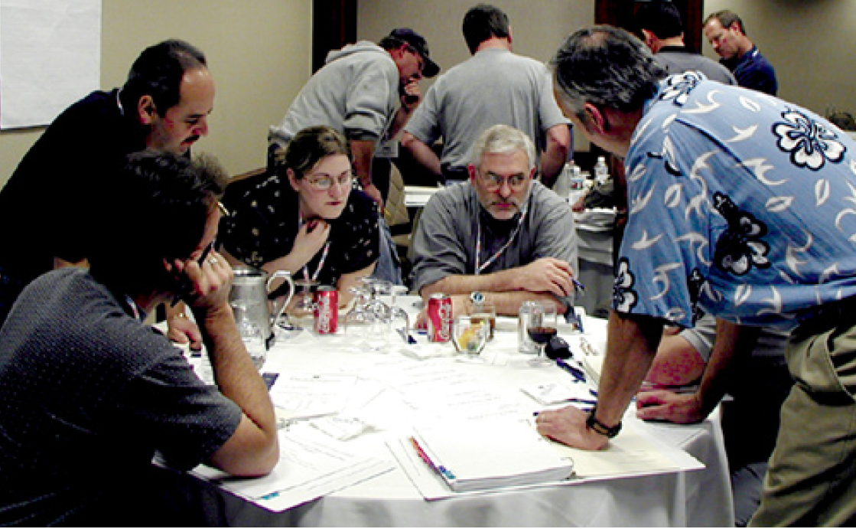
PARTNERSHIPS?
Why is the SALT council so important?
Notes:
Brings together all interested parties to create a safer community for older adults
Affords an older adult voice in programs being planned for them
Allows senior adults to help senior adults
Saves law enforcement MANPOWER through volunteerism
Builds trust between law enforcement and the community

Slide 36




What are some typical activities of a Triad ?
Notes:
You have a SALT Council – now what?
Educate seniors on:
Safety issues
Avoiding criminal victimization
Fraud and scams
Financial Crimes
Elder abuse
Law enforcement activities
Legal system
Social aspect / teamwork

Slide 37

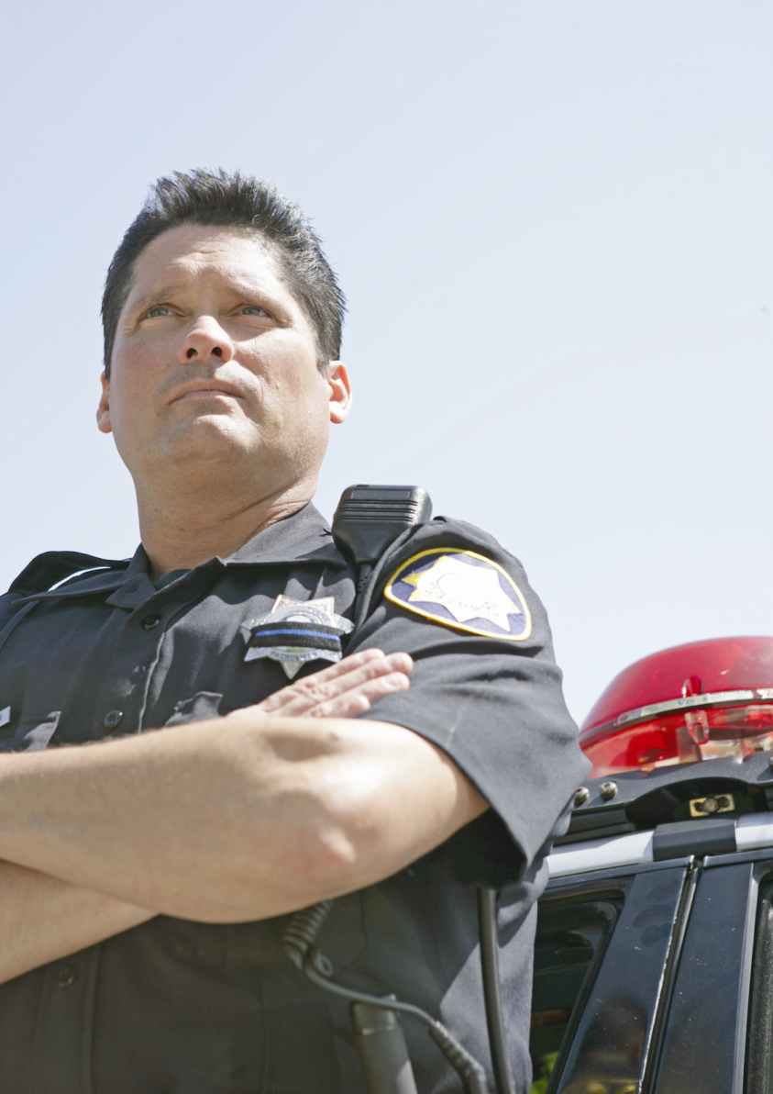
Other activities……...
Court Watch program
Victim assistance
Safe senior walks
Law enforcement volunteers
Vulnerable Older Adult Daily Calls
House Numbering
Yellow Dot Program
Emergency Beacon Lighting

Slide 38
Questions?
Edward Hutchison
Triad Program Director
National Association of Triads, Inc
(800) 424-7827 x326
ehutchison@sheriffs.org

